Slide 1

What's New In IOS Development - XCode 7 + Swift 2
View iOS App Development using Swift 2.0 course details at www.edureka.co/ios-development
For Queries:
Post on Twitter @edurekaIN: #askEdureka
Post on Facebook /edurekaIN
For more details please contact us:
US : 1800 275 9730 (toll free)
INDIA : +91 88808 62004
Email Us : webinars@edureka.co

Slide 2
Objectives
At the end of this session, you will be able to:
Learn about New Features in Xcode 7
Using guard instead of if - let
Implement Error Handling in Swift 2
Learn about Replacement of Println()
Implement Protocol Extension
Understand Availability Checking in Swift 2
Learn about repeat-while
Create an iOS App using Swift 2

Slide 3
New in iOS Development : Xcode 7
User interface testing uses accessibility to auto-generate tests for you and run them as part of a test suite
Code coverage displays what parts of your code are covered (and not) by your test suite
Interface Builder adds StackViews to simplify the construction of complex interfaces that use Auto Layout
Game level editors add an animation design timeline with both 2D and 3D support
Crash logs management adds support for OS X and app extensions
Address sanitizer points out code that may crash at runtime even when you cannot reproduce yourself
App thinning uploads all assets to the App Store so the store can then send an optimized app to your customers

Slide 4
New in iOS Development : Swift 2.0

Slide 5
Error Handling
When a function fails, your need to find the reason of the failure. The proper error handling model was lacking in Swift 1
In Swift 2, it comes with an exception-like model using try / throw / catch keywords
In Swift, errors are represented by values of types conforming to the ErrorType protocol
Let take an example that you are modelling ending for a car, the reasons for failure of the engine can be :
No Fuel
Oil Leakage
Low Battery

Slide 6
Error Handling
Lets create an enumeration for all the reasons for engine failure
enum CarEngineErrors: ErrorType {
case NoFuel
case OilLeak
case LowBattery
}
Use throws keyword with the function that can throw errors
func checkEngine() throws {
}

Slide 7
Error Handling
Use throw statement inside the function to throw the errors. Example:
let fuelReserve = 20.0
let oilOk = true
let batteryReserve = 0.0
func checkEngine() throws {
guard fuelReserve > 0.0 else {
throw CarEngineErrors.NoFuel
}
guard oilOk else {
throw CarEngineErrors.OilLeak
}
guard batteryReserve > 0.0 else {
throw CarEngineErrors.LowBattery
}
}
guard keyword has been introduced in Swift 2, When the control reaches the guard statement, it first checks the condition. If the condition evaluates to false, the else part will be executed

Slide 8
Error Handling
To call the throwing function, you put the try keyword in front of the call
func startEngine() {
try checkEngine()
}
The error handling model in Swift requires you to use a do-catch statement to catch all errors and handle them

Slide 9
No More Println()
In Swift 2, Apple has combined both println() and print() functions into one
If you want to output something with a newline, you can set the appendNewline parameter to true
For Example:
print(“Welcome to Swift 2", appendNewline: true)

Slide 10
Protocol Extensions
Swift 2 allows developers to apply extensions to protocol types. With Protocol Extensions, you can add functions or properties to all classes that conform to a certain protocol
The is useful when you want to extend the protocol’s functionality. Let us create a protocol Excellent
protocol Excellent {
func ExcellentPercentage() -> Float
}
Now we declare two classes that use Excellent protocol

Slide 11
Protocol Extensions
class Hadoop_Course: Awesome {
var course_id : Int!
func ExcellentPercentage() -> Float {
return 0.95
}
}
class Storm_Course: Awesome {
var course_id : Int!
func ExcellentPercentage() -> Float {
return 0.90
}
}
let hadoop = Hadoop_Course()
Hadoop.ExcellentPercentage()
let storm = Storm_Course()
storm.ExcellentPercentage()
Output:
Hadoop_Course
0.95
Storm_Course
0.90

Slide 12
Protocol Extensions
Let us now extend the Excellent protocol to provide an ExcellentIndex property, which uses the result of the ExcellentPercentage() method
extension Excellent {
var ExcellentIndex: Int {
get {
return Int(ExcellentPercentage() * 100)
}
}
}
hadoop.ExcellentIndex
storm.ExcellentIndex
Output:
Hadoop_Course
95
Storm_Course
90

Slide 13
Availability Checking
Sometimes building an app that supports multiple iOS versions can be a pain. Difference in API version and IOS version may cause errors when the app is running
Prior to Swift 2, there is no standard way to do availability check
In Swift 2, we have built-in support to check for API availability. You can define an availability condition so that a particular block of code will only be executed on certain iOS versions
If #available(iOS 8, *) {
// iOS 8 or up
let queryItem = NSURLQueryItem()
} else {
// Earlier iOS versions
}

Slide 14
do-while is now repeat-while
In Swift 2, we use repeat-while instead of do-while
var i = 0
repeat {
i++
print(i)
} while i < 10

Slide 15
Let us see these features in an iOS movie APP

Slide 16

Trakt Movie App

Slide 17
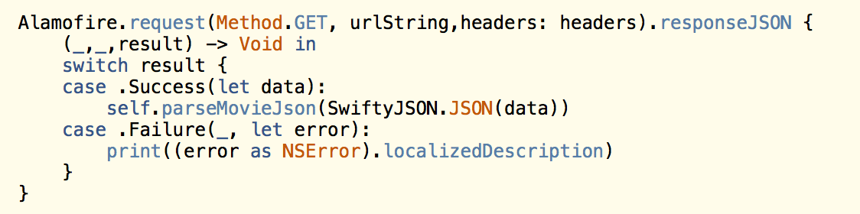
Alomofire
Elegant HTTP Networking in Swift

Slide 18
HanekeSwift

Slide 19
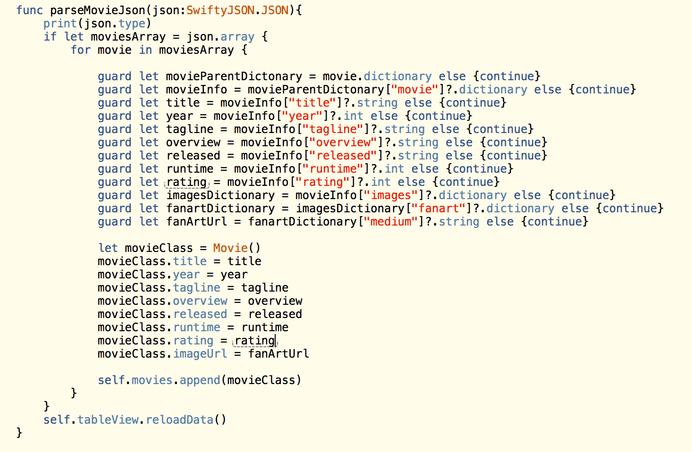
SwiftJSON

